Slide 1
Predictability of Winter Wheat Yield
Paul Hughes
Data Science Intensive Capstone Project
April 4, 2024

Slide 2
Problem Statement
Is it possible to predict the yield of winter wheat to help mitigate the farmer’s risk and maximize their profitability?

Slide 3
Key Idea
Winter wheat is typically planted in the fall season and is harvested in the summer season of the following year

Slide 4
Key Idea
Winter wheat is typically planted in the fall season and is harvested in the summer season of the following year
Corn, cotton, rice, and soybean are typically planted in the spring and harvested in the fall of the same year

Slide 5
Key Idea
Winter wheat is typically planted in the fall season and is harvested in the summer season of the following year
Corn, cotton, rice, and soybean are typically planted in the spring and harvested in the fall of the same year
Can the yield of corn, cotton, rice, and soybean be used to predict the following season’s yield of winter wheat?

Slide 6
Let’s Look at the Data
To understand the initial degree of of predictability of winter wheat, this work strictly used crop yield data for the state of Missouri

Slide 7
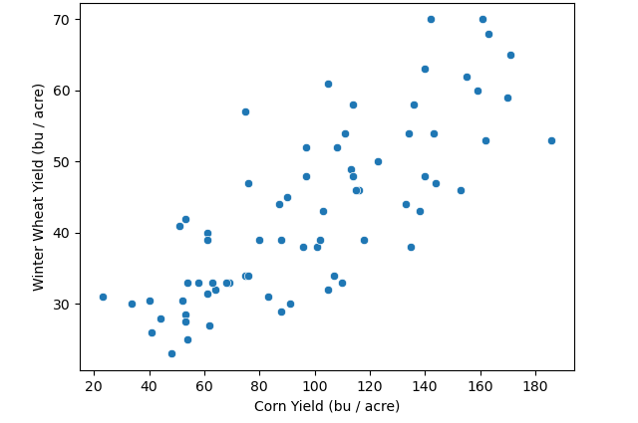
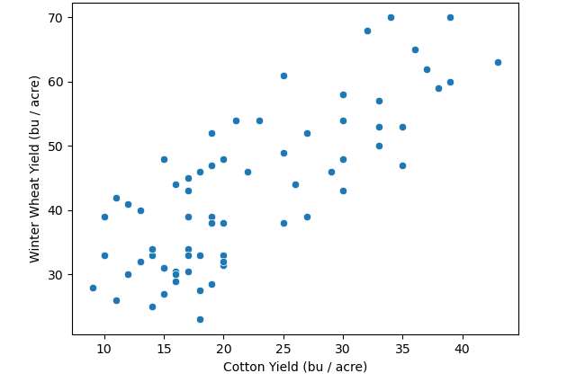
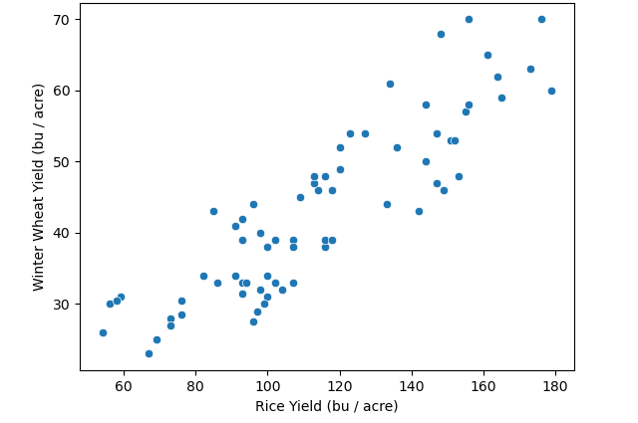
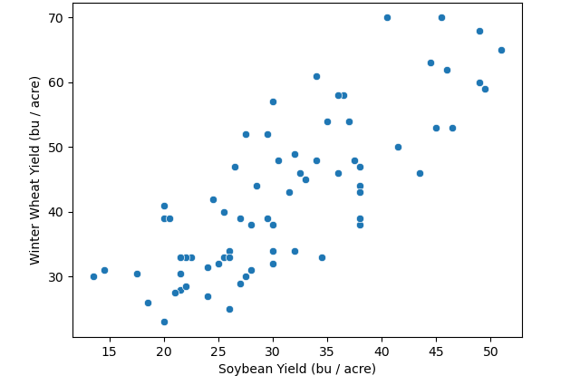
Winter Wheat vs. Corn
Winter Wheat vs. Cotton
How does the winter wheat yield relate to the previous year’s yield of corn, cotton, rice, & soybean?
Data Source:
United States Department of Agriculture (USDA)
Winter Wheat vs. Rice
Winter Wheat vs. Soybean

Slide 8
Winter Wheat vs. Corn
Winter Wheat vs. Cotton
How does the winter wheat yield relate to the previous year’s yield of corn, cotton, rice, & soybean?
Data Source:
United States Department of Agriculture (USDA)
Winter Wheat vs. Rice
Winter Wheat vs. Soybean

Slide 9
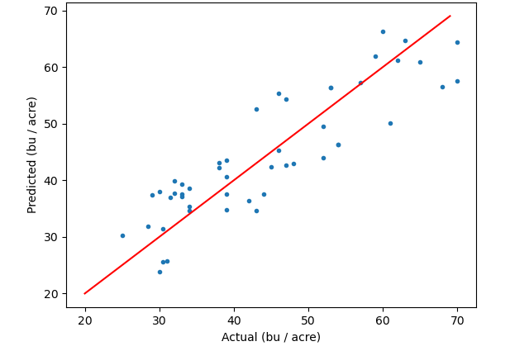
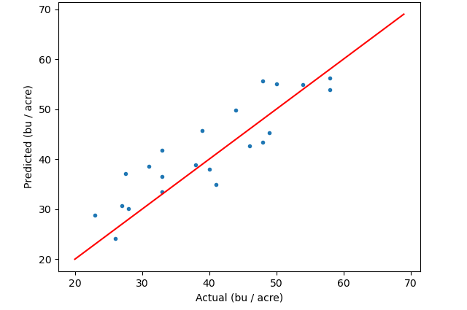
Modeling: Linear Regression
Winter Wheat Yield: Training
Winter Wheat Yield: Test

Slide 10
Modeling: Linear Regression
Table 1. Evaluation of linear regression model to ground truth
 | Training Data | Test Data
Mean Squared Error (MSE) | 35.10 | 25.73
Root Mean Square Error (RMSE) | 5.92 | 5.07
Mean Absolute Error (MAE) | 5.15 | 4.37
R-squared | 0.77 | 0.76
Mean 5-fold cross validation score | 0.72 | ----
Standard deviation of cross validation score | 0.08 | ----

Slide 11
Modeling: Linear Regression
Table 1. Evaluation of linear regression model to ground truth
 | Training Data | Test Data
Mean Squared Error (MSE) | 35.10 | 25.73
Root Mean Square Error (RMSE) | 5.92 | 5.07
Mean Absolute Error (MAE) | 5.15 | 4.37
R-squared | 0.77 | 0.76
Mean 5-fold cross validation score | 0.72 | ----
Standard deviation of cross validation score | 0.08 | ----

Slide 12
Modeling: Linear Regression
Table 1. Evaluation of linear regression model to ground truth
 | Training Data | Test Data
Mean Squared Error (MSE) | 35.10 | 25.73
Root Mean Square Error (RMSE) | 5.92 | 5.07
Mean Absolute Error (MAE) | 5.15 | 4.37
R-squared | 0.77 | 0.76
Mean 5-fold cross validation score | 0.72 | ----
Standard deviation of cross validation score | 0.08 | ----

Slide 13
Modeling: Linear Regression
Table 1. Evaluation of linear regression model to ground truth
 | Training Data | Test Data
Mean Squared Error (MSE) | 35.10 | 25.73
Root Mean Square Error (RMSE) | 5.92 | 5.07
Mean Absolute Error (MAE) | 5.15 | 4.37
R-squared | 0.77 | 0.76
Mean 5-fold cross validation score | 0.72 | ----
Standard deviation of cross validation score | 0.08 | ----

Slide 14
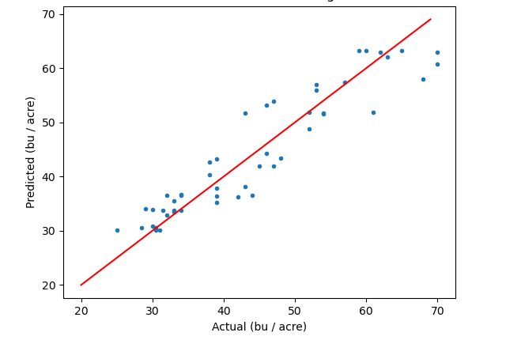

Modeling: Random Forest Regression
Winter Wheat Yield: Training
Winter Wheat Yield: Test

Slide 15
Modeling: Random Forest Regression
Table 2. Evaluation of random forest model to ground truth
 | Training Data | Test Data
Mean Squared Error (MSE) | 6.00 | 26.19
Root Mean Square Error (RMSE) | 2.45 | 5.12
Mean Absolute Error (MAE) | 2.03 | 4.52
R-squared | 0.96 | 0.76
Mean 5-fold cross validation score | 0.67 | ----
Standard deviation of cross validation score | 0.12 | ----

Slide 16
Modeling: Random Forest Regression
Table 2. Evaluation of random forest model to ground truth
 | Training Data | Test Data
Mean Squared Error (MSE) | 6.00 | 26.19
Root Mean Square Error (RMSE) | 2.45 | 5.12
Mean Absolute Error (MAE) | 2.03 | 4.52
R-squared | 0.96 | 0.76
Mean 5-fold cross validation score | 0.67 | ----
Standard deviation of cross validation score | 0.12 | ----

Slide 17
Modeling: Random Forest Regression
Table 2. Evaluation of random forest model to ground truth
 | Training Data | Test Data
Mean Squared Error (MSE) | 6.00 | 26.19
Root Mean Square Error (RMSE) | 2.45 | 5.12
Mean Absolute Error (MAE) | 2.03 | 4.52
R-squared | 0.96 | 0.76
Mean 5-fold cross validation score | 0.67 | ----
Standard deviation of cross validation score | 0.12 | ----

Slide 18
Modeling: Random Forest Regression
Table 2. Evaluation of random forest model to ground truth
 | Training Data | Test Data
Mean Squared Error (MSE) | 6.00 | 26.19
Root Mean Square Error (RMSE) | 2.45 | 5.12
Mean Absolute Error (MAE) | 2.03 | 4.52
R-squared | 0.96 | 0.76
Mean 5-fold cross validation score | 0.67 | ----
Standard deviation of cross validation score | 0.12 | ----

Slide 19
Model Selection
Table 3. Model comparison
 | Linear Regression | Random Forest
Mean Squared Error (MSE) | 25.73 | 26.19
Root Mean Square Error (RMSE) | 5.07 | 5.12
Mean Absolute Error (MAE) | 4.37 | 4.52
R-squared | 0.76 | 0.76
Mean 5-fold cross validation score | 0.72 | 0.67
Standard deviation of cross validation score | 0.08 | 0.12

Slide 20
Model Selection
Table 3. Model comparison
 | Linear Regression | Random Forest
Mean Squared Error (MSE) | 25.73 | 26.19
Root Mean Square Error (RMSE) | 5.07 | 5.12
Mean Absolute Error (MAE) | 4.37 | 4.52
R-squared | 0.76 | 0.76
Mean 5-fold cross validation score | 0.72 | 0.67
Standard deviation of cross validation score | 0.08 | 0.12
Test

Slide 21
Model Selection
Table 3. Model comparison
 | Linear Regression | Random Forest
Mean Squared Error (MSE) | 25.73 | 26.19
Root Mean Square Error (RMSE) | 5.07 | 5.12
Mean Absolute Error (MAE) | 4.37 | 4.52
R-squared | 0.76 | 0.76
Mean 5-fold cross validation score | 0.72 | 0.67
Standard deviation of cross validation score | 0.08 | 0.12
Training

Slide 22
Model Selection
Table 3. Model comparison
 | Linear Regression
Mean Squared Error (MSE) | 25.73
Root Mean Square Error (RMSE) | 5.07
Mean Absolute Error (MAE) | 4.37
R-squared | 0.76
Mean 5-fold cross validation score | 0.72
Standard deviation of cross validation score | 0.08

Slide 23
Conclusions
It is possible to accurately predict the yield of winter wheat in Missouri given the previous year’s yield of corn, cotton, rice, & soybean
Based on comparison to ground truth, the linear regression model was chosen
The model is not ready for real-time application

Slide 24
Further Research
Extend beyond Missouri by including crop yield data from neighboring states (e.g., Kansas, Nebraska, Iowa, & Illinois)
Add information through modes of climate variability (e.g., El Nino-Southern Oscillation, Pacific Decadal Oscillation, Arctic Oscillation, etc.)
Add information through soil characteristics prior to winter wheat planting

